Slide 1


A Whirlwind Tour of LLMs
April 9, 2024
QMSS GR5069
Eitan
Jacob

Slide 2
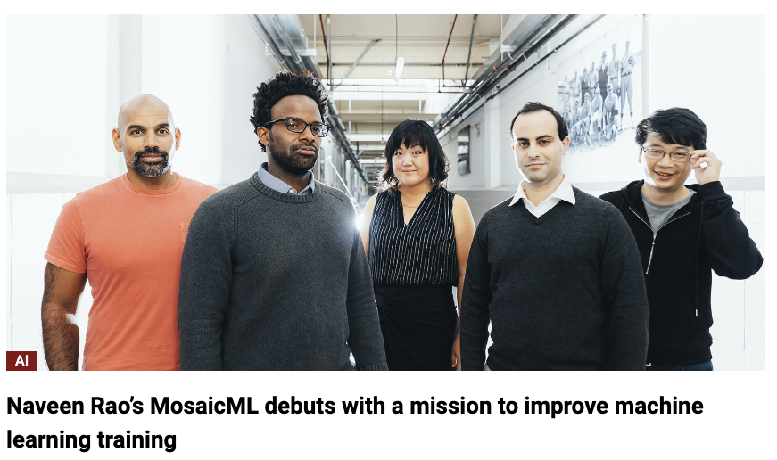
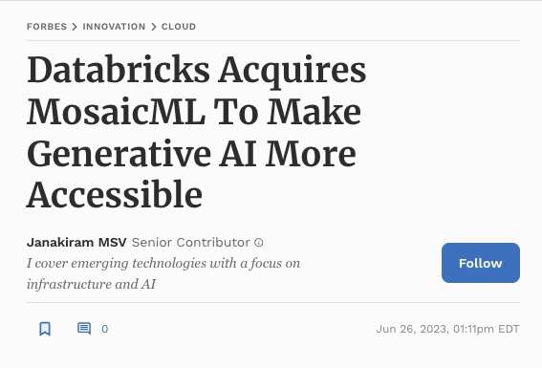

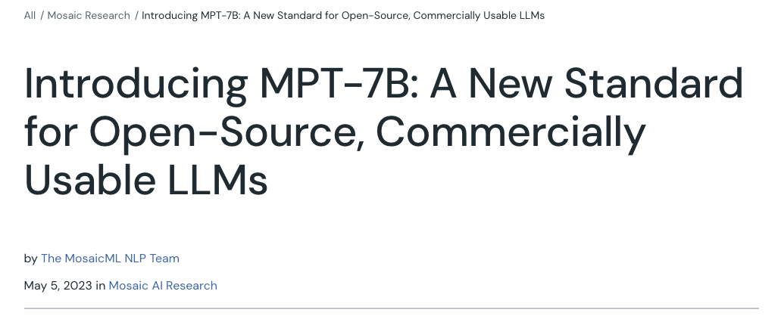
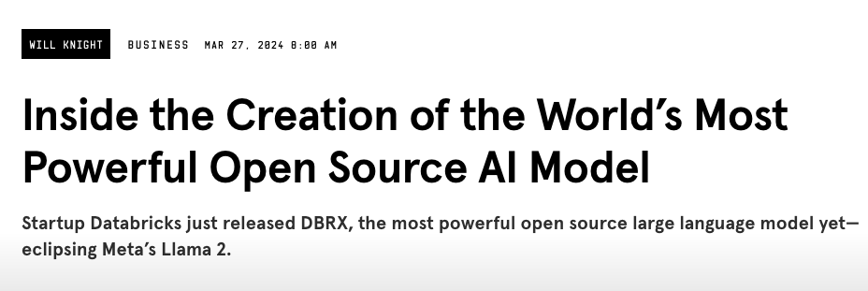
A bit about our journey

Slide 3
LLM Trivia
How many people have used LLMs besides GPT4? Which ones?
Perplexity? You.com? Bing?
How much GPT4 cost to train?
What data went into GPT4?
How many people here believe the US should allow companies to open source LLM models?
Who here is worried about the risks of AI? Which risks in particular?
Do people think that AI will replace jobs? Or “enhance productivity?” Or both?

Slide 4
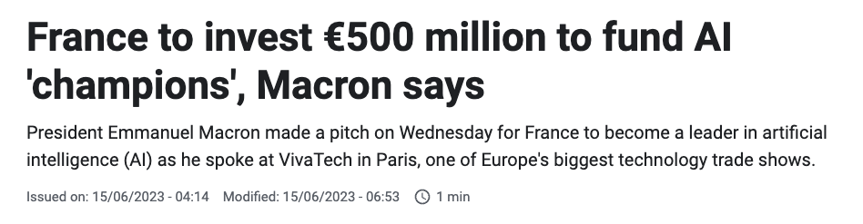


Why should we care about LLMs?
🤓 Nerd factor - it is incredibly cool that these things work!
Economics - NVIDIA $2T valuation, OpenAI valuation at $80B
Political - US Chips Act, TSMC to build factory in the US, France invests €500M in AI, Canada invests $2B in AI, Saudi Arabia raises $40B AI fund,
Social - will AI replace employees? Will ChatGPT ruin the college education? AI companions,
Science - protein folding
…not to mention the potential harm such as surveillance and misinformation

Slide 5
Main themes
How do LLMs work?
What LLMs should you use and why?
What evaluation benchmarks matter and why?
When should you finetune?
What are some rules of thumb around hardware?
What can these models be used for?
What are these models are bad at?
What are open research questions?

Slide 6
Part 1: LLM Overview

Slide 7

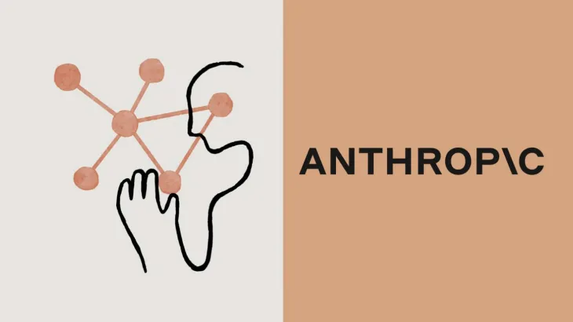


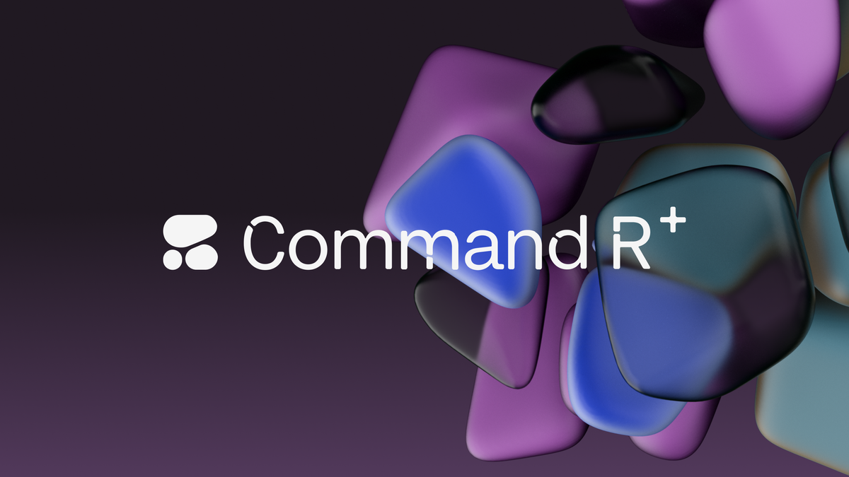

What we mean when we talk about LLMs
Proprietary (closed source) LLMs:
ChatGPT, GPT4 (OpenAI)
Claude (Anthropic)
Gemini (Google)
Pi (Inflection)
Open Source LLMs
LLama-7B, 13B, 70B (Meta)
Command-R (Cohere)
DBRX (Databricks)
Mistral (Mistral AI)
…
BERT, T5, GPT2, OPT, Pythia
…

Slide 8
The Stages of building and serving LLMs
Data Collection
Pretraining
Finetuning
Evaluation
Serving

Slide 9
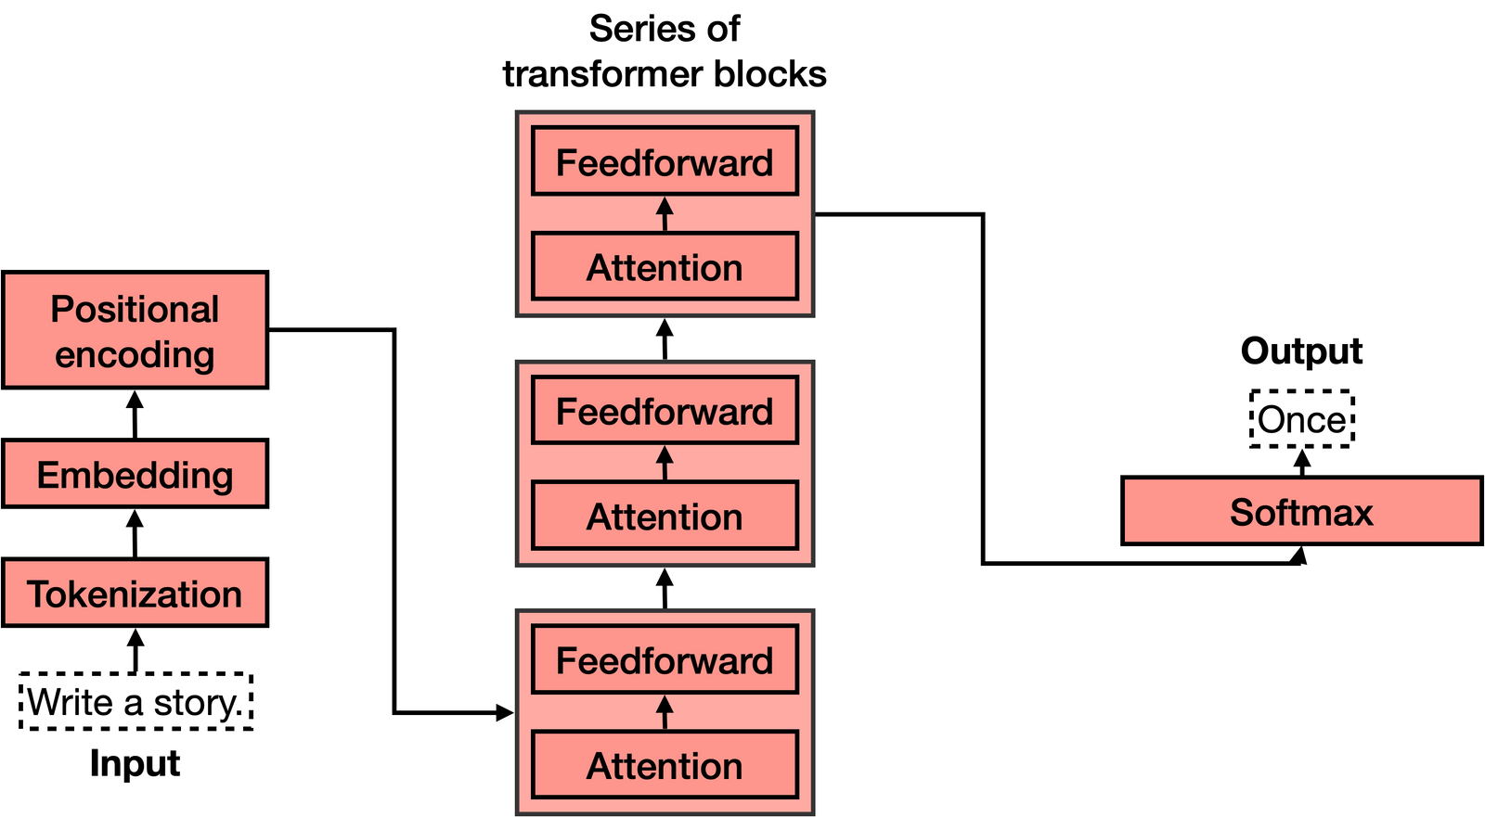
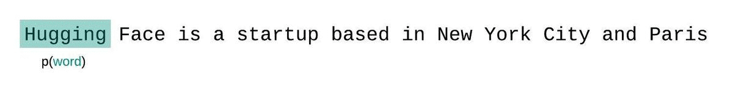
Pretraining
Next token prediction (aka causal language modeling)
“Unsupervised” - the data does not need any human labelers
Core architecture is the transformer block

Slide 10
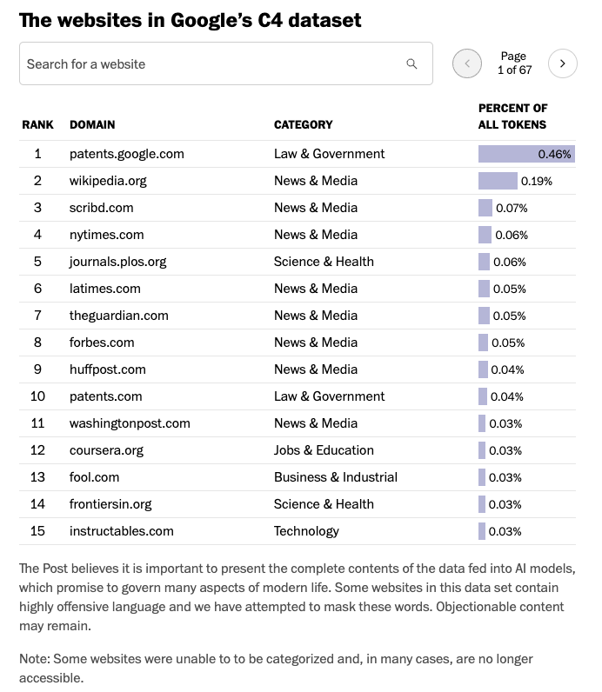

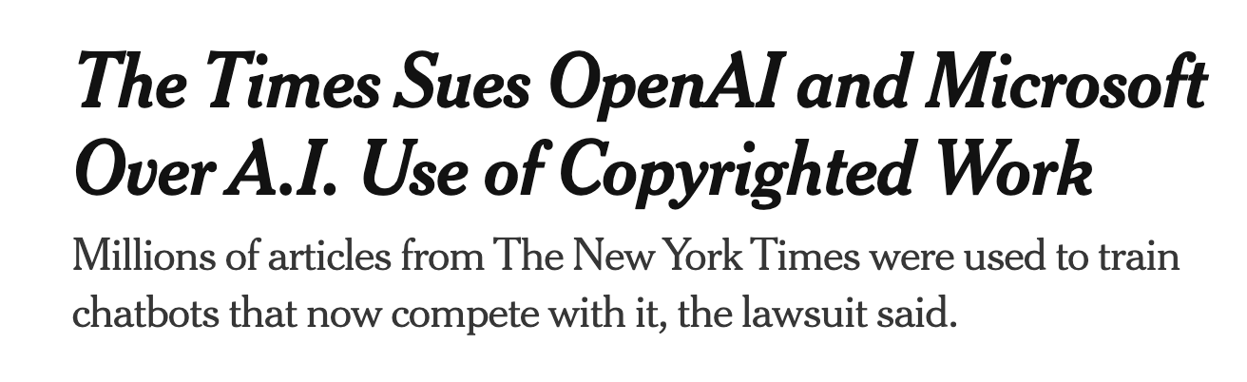
Pretraining Data
Example Datasets
“C4” 750GB (from the CommonCrawl nonprofit open repository of web crawls)
ThePile (famously contains “Books3” copyrighted books)
What is good data?
Open source textbooks, well-written forum threads
What is bad data?
Html tags, poorly scraped websites
[Washington Post] Inside the secret list of websites that make AI like ChatGPT sound smart (April 2023)

Slide 11
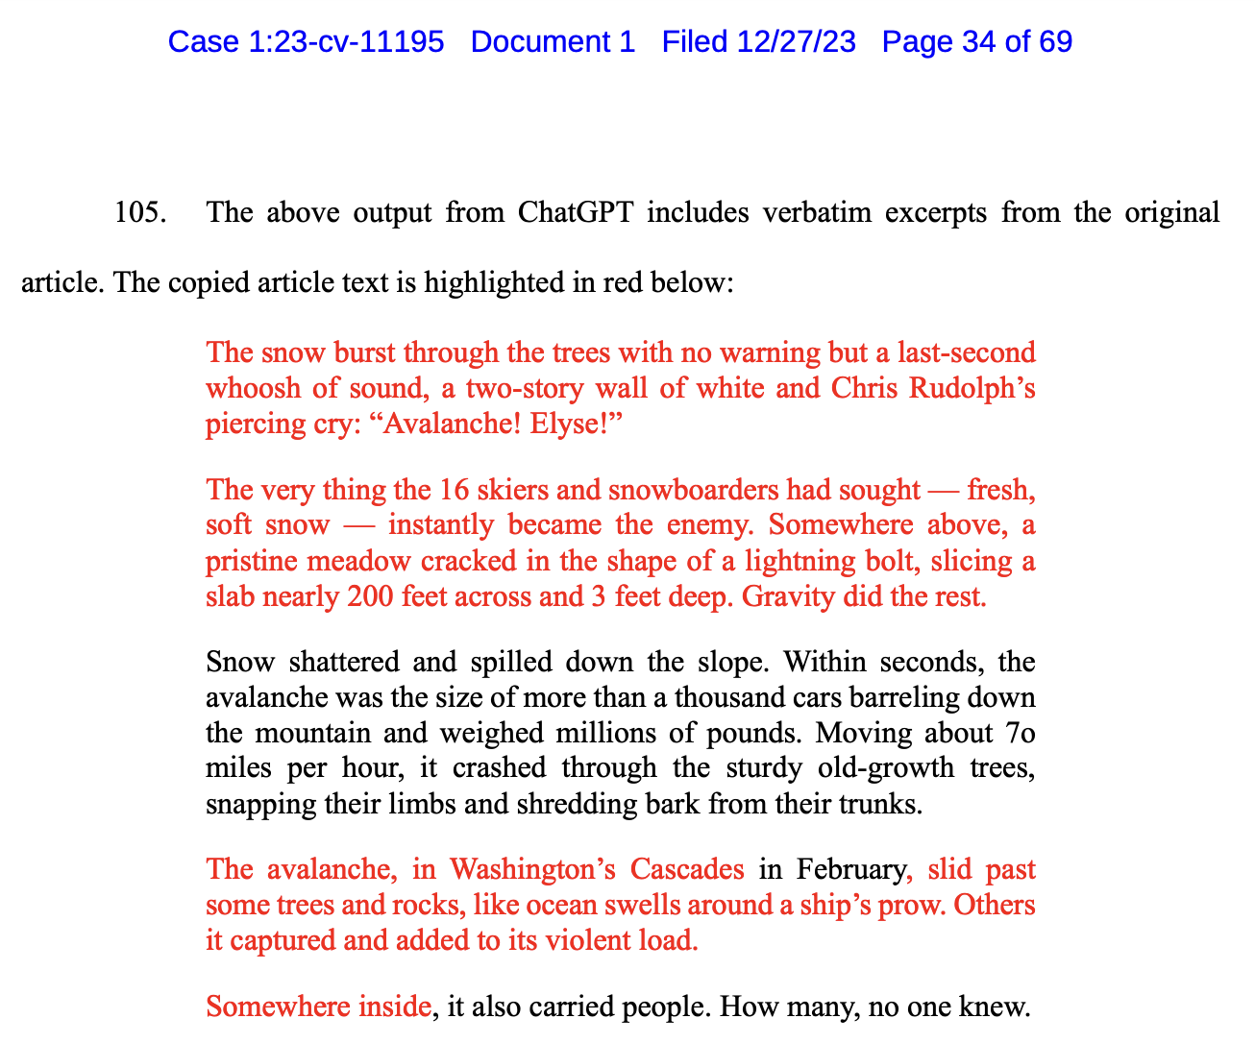
Pretraining Data
Example: NYT Lawsuit against OpenAI has many examples of ChatGPT regurgitating NYT content verbatim
https://nytco-assets.nytimes.com/2023/12/NYT_Complaint_Dec2023.pdf

Slide 12
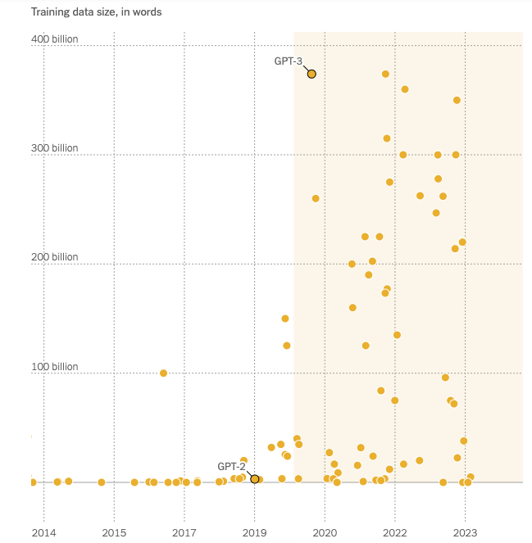
How much data?
How much data should you train on?
How much data exists on the public internet?
Example models:
GPT3: 500 billion tokens
Llama-7B: 2 trillion tokens
DBRX: 12 trillion tokens
GPT4: 13 trillion tokens (estimated)
Important relationship between model size and dataset size i.e. “scaling laws”
(NYT) How Tech Giants Cut Corners to Harvest Data for A.I.

Slide 13
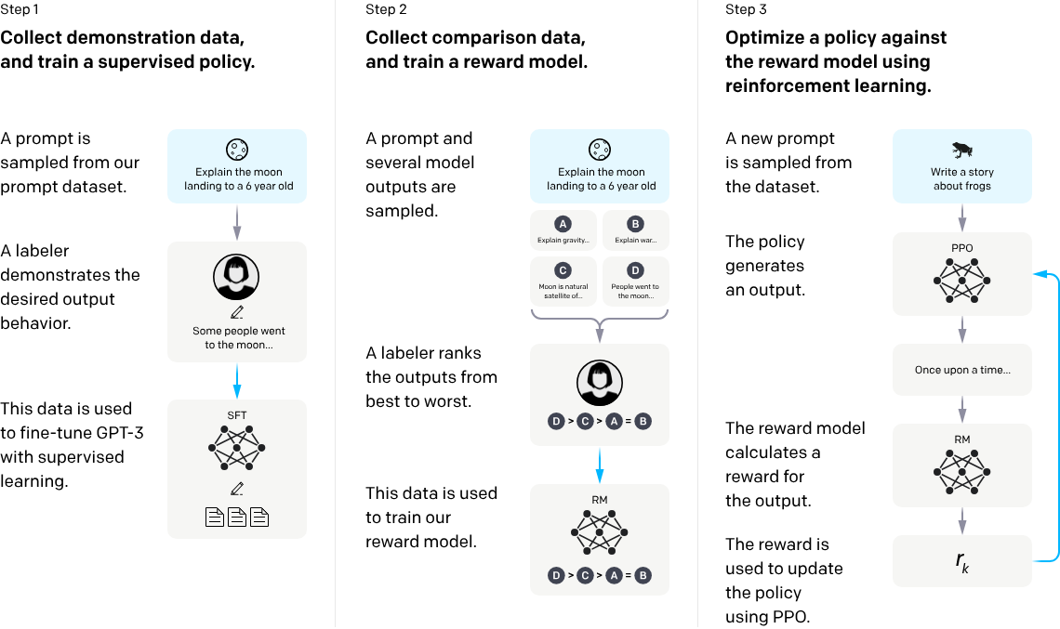
Reinforcement Learning with Human Feedback (RLHF)
https://openai.com/research/instruction-following
Notes:
One way of thinking about this process is that it “unlocks” capabilities that GPT-3 already had, but were difficult to elicit through prompt engineering alone: this is because our training procedure has a limited ability to teach the model new capabilities relative to what is learned during pretraining, since it uses less than 2% of the compute and data relative to model pretraining.

Slide 14
Intuition Behind RLHF
From the OpenAI blogpost (Aligning language models to follow instructions, Jan 2022):
> RLHF…“unlocks” capabilities that GPT-3 already had, but were difficult to elicit through prompt engineering alone
> A limitation of this approach is that it introduces an “alignment tax”: aligning the models only on customer tasks can make their performance worse on some other academic NLP tasks.

Slide 15
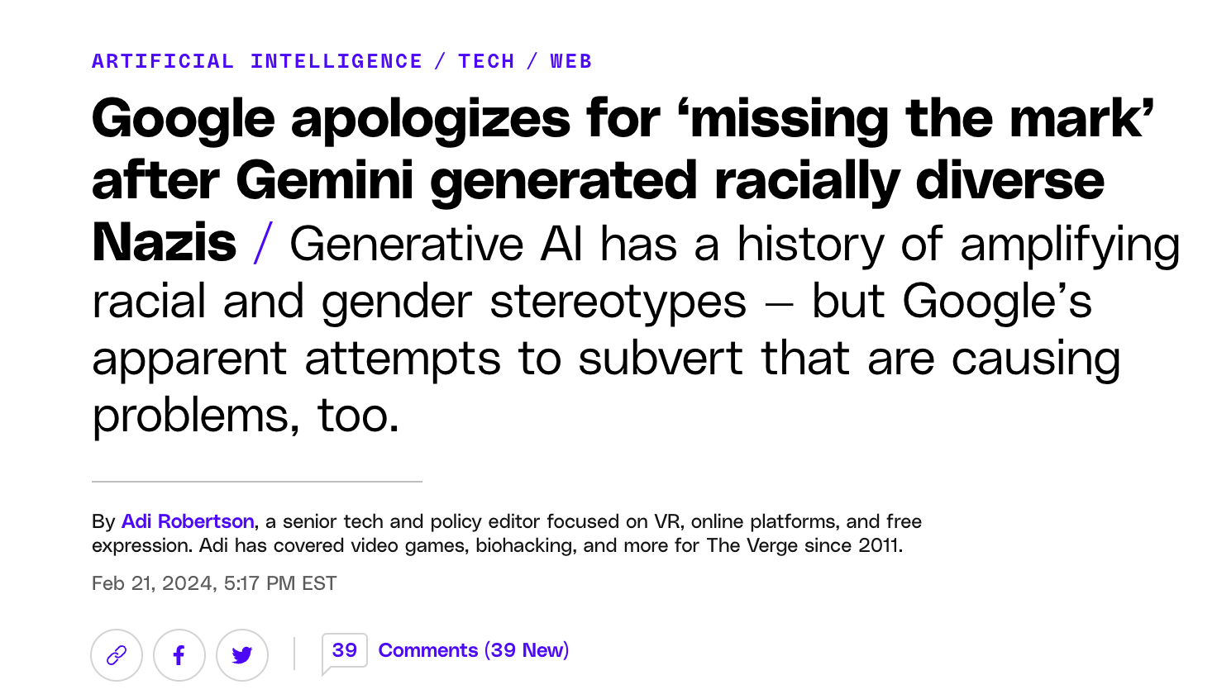
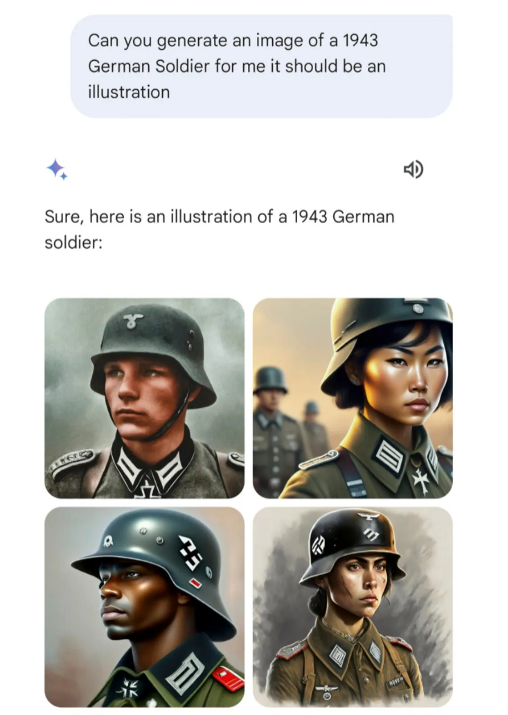
AI Safety and Alignment
General approaches to alignment
Heavily filter the pretraining data
Finetune on a special, curated datasets
“Human in the loop” via RLHF
Safety filter in the user interface
The Gemini “…controversy has been promoted largely — though not exclusively — by right-wing figures attacking a tech company that’s perceived as liberal. “
https://www.telegraph.co.uk/news/2024/02/23/google-gemini-ai-images-wrong-woke/
https://www.theverge.com/2024/2/21/24079371/google-ai-gemini-generative-inaccurate-historical

Slide 16
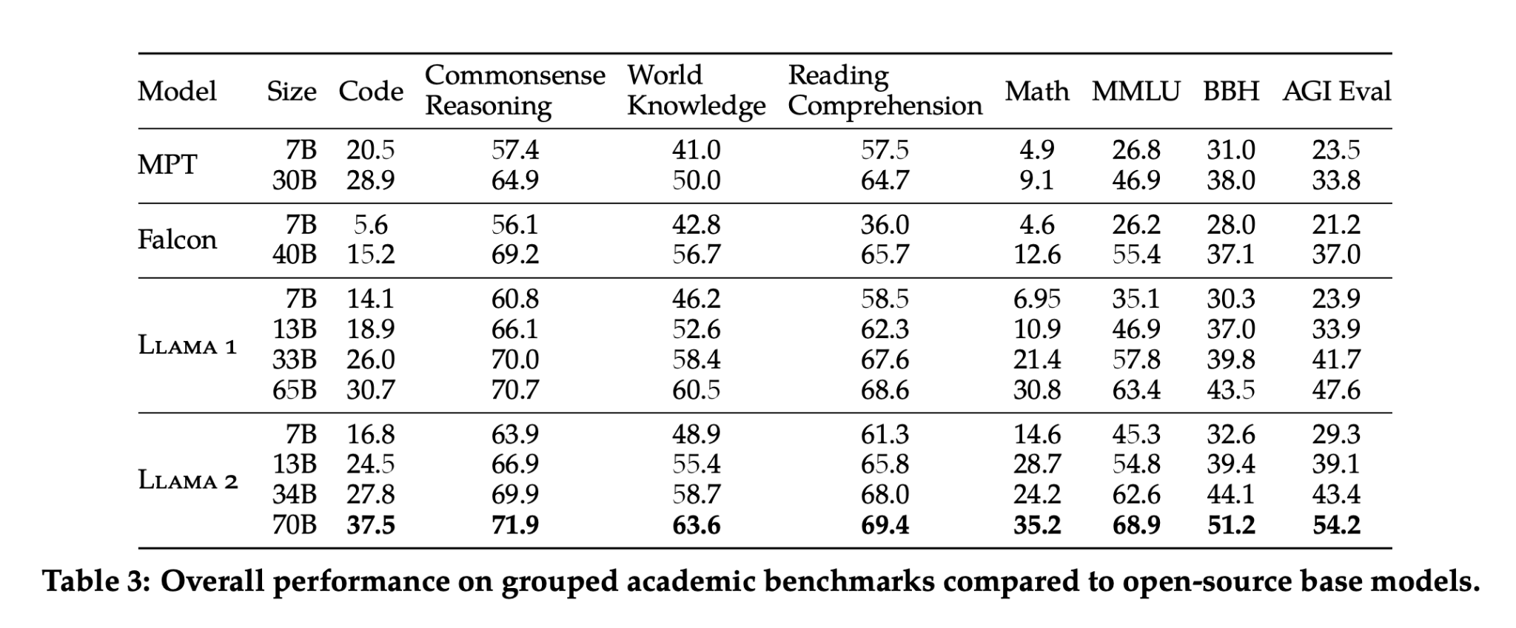
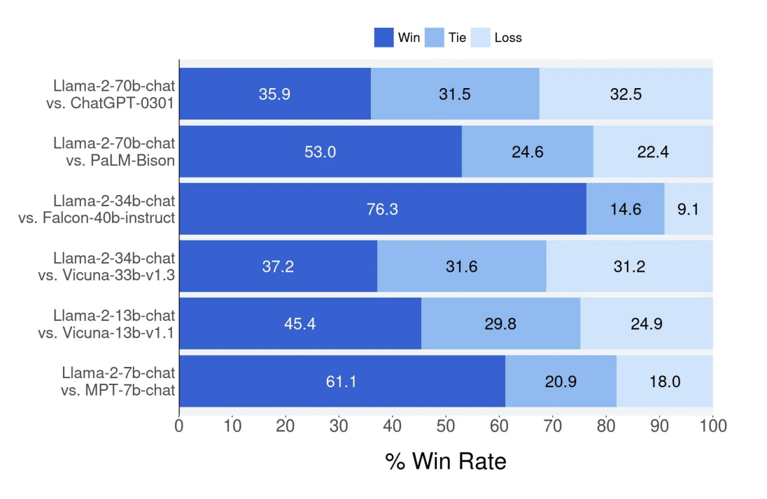
Evaluation
Two paradigms: perplexity based, and more recently, LLM-as-a-judge
Figures from the Llama2 Paper

Slide 17
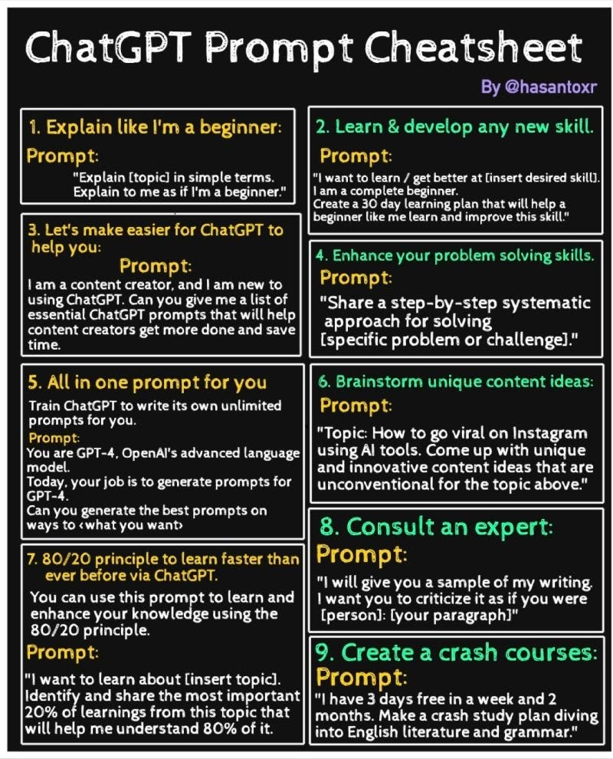
Prompt Engineering - is this a real thing? Yes!
👍 The larger and more powerful the model, the less prompt engineering and in context learning is necessary
https://kyleake.medium.com/prompt-engineering-guide-for-ai-enthusiasts-2f0334dae165

Slide 18
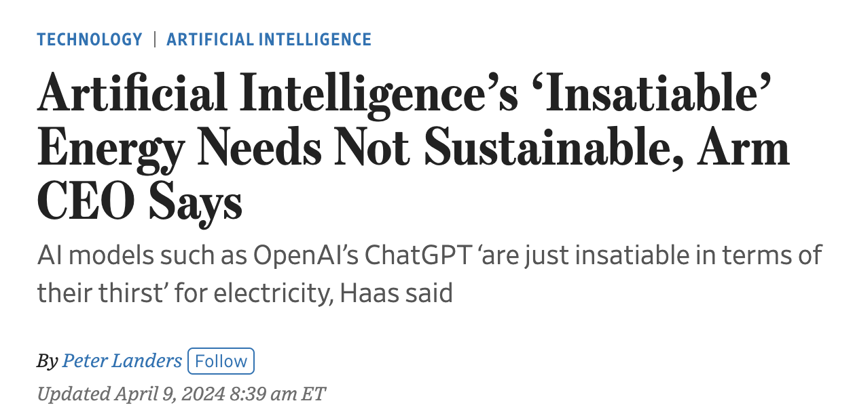
Serving
How do companies efficiently support LLMs?
> “In a January report, the International Energy Agency said a request to ChatGPT requires 2.9 watt-hours of electricity on average—equivalent to turning on a 60-watt lightbulb for just under three minutes. That is nearly 10 times as much as the average Google search.” [WSJ: Artificial Intelligence’s ‘Insatiable’ Energy Needs Not Sustainable, Arm CEO Says 4/9/2024]

Slide 19
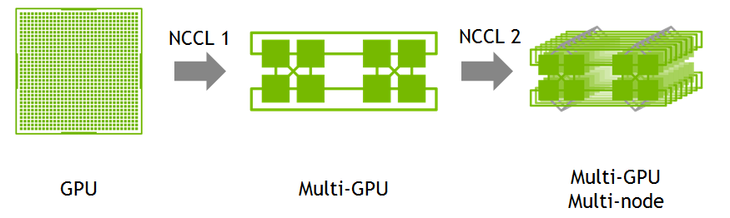
GPUs for Training and Serving 🛠️
A single node can contain multiple GPUs connected in the same “box”
Multinode training involves multiple nodes. The nodes are distributed and communication is slower
See also A Gentle Introduction To Multi GPU And Multi Node Distributed Training and Efficient Training on Multiple GPUs (HuggingFace)
https://www.mn.uio.no/ifi/studier/masteroppgaver/nd/fast-multi-gpu-communication-over-pcie.html

Slide 20
Important Tools 🛠️
Neural Network Training
PyTorch
TensorFlow
PyTorch Lightning
HuggingFace (also a model hub, and a great learning resource!)
Experiment Tracking
Weights&Biases, TensorBoard, MLFlow
GPU Orchestration
Slurm, kubernetes
Modal, Replit (startups)

Slide 21
Part 2: How LLMs Work

Slide 22
What are Neural Networks?
What is the difference between machine learning vs. neural networks?
Machine Learning is the broad class of algorithms that can learn from data. Neural networks are arguably the most powerful ML systems in the toolbox!
Basic idea:
Transform inputs through layers of matrices and other mathematical operations
Define a function to optimize i.e. a loss function or objective function
Update the weights of the network 🧠
How do you “optimize the loss function”?
Calculate the gradient of the loss function with respect to the weights
Update the weights using the backpropagation algorithm
Need to use an optimizer algorithm for best results! (e.g. Stochastic Gradient Descent “SGD”, Adam, etc.)

Slide 23
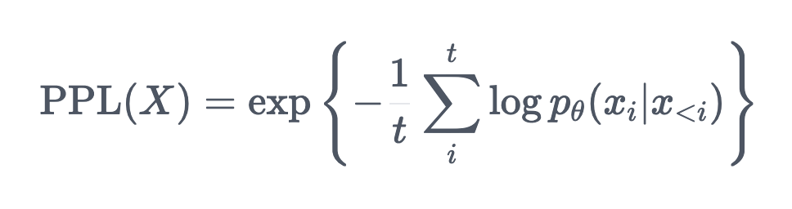
What is the LLM “Loss Function”? Next Token Prediction and Perplexity
Intuitively, we want to calculate the probability of a word given the preceding words, and choose the most likely word
Perplexity is defined as the exponentiated average negative log-likelihood of a sequence X.
Perplexity can be thought of as a measure of how "surprised" the model is by the data. A lower perplexity indicates the model is better at predicting the next token
Related concepts: Cross Entropy
https://huggingface.co/docs/transformers/perplexity

Slide 24
Tokenization
Fundamental step in the NLP pipeline.
Converts raw text into a format that can be processed by models
Tokenization can be done at different levels, such as by words, characters, or even subwords.
GPT4 tokenizer playground: https://platform.openai.com/tokenizer

Slide 25
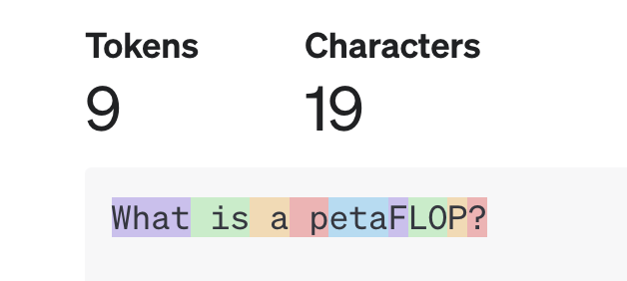
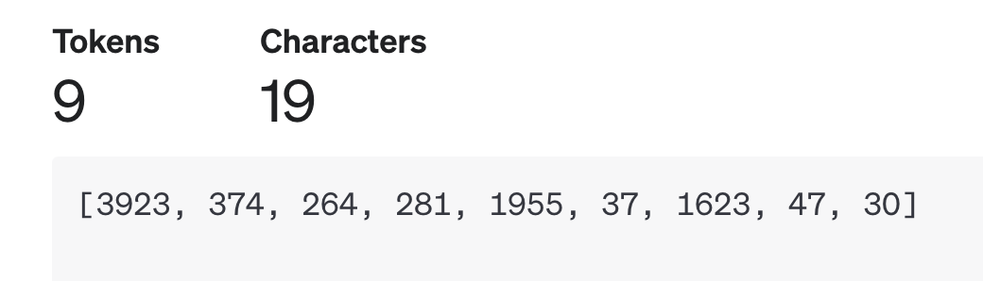
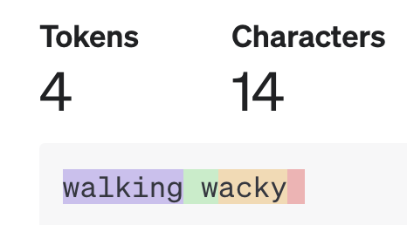
Example: Using the GPT4 tokenizer
👉 GPT4 tokenizer playground: https://platform.openai.com/tokenizer
The GPT4 tokenizer chops “What is a petaFLOP into 9 tokens
These are represented as numbers in the tokenizer “dictionary” or “vocabulary.”
In this tokenizer, some words remain whole (i.e. get their own vocab ID) - “walking”
Other words get split - “_w” + “acky” + “_”

Slide 26
👍 Some Rules of Thumb around Tokenization
For a nice introduction to tokenization and tokenizers, see Tokenizers (HF NLP Course) and Summary of the Tokenizers (HF Conceptual Guide)
Tokenizers are built algorithmically based on a corpus. There are many tokenization algorithms and many tokenizers
Each model on HuggingFace is paired with an associated tokenizer
If you want to use a HuggingFace model, you must use the correct tokenizer!
Different tokenizers split words differently!
Some tokenizers handle different languages (e.g. Chinese) uniquely
If you are using LLMs via an API, you will (likely) be charged based on the # of tokens

Slide 27
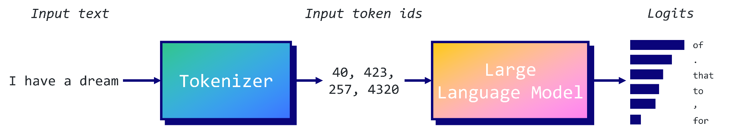
Logits
Logits are the raw, unnormalized output values from a neural network's output layer
Logits are scores assigned to every possible token in the tokenizer vocabulary
👍 Some APIs will give you access to the logits, others won’t

Slide 28
LLM Decoding
So for a given text input, you get a bunch of logits. Then what?
Greedy search is a decoding method that takes the most probable token at each step as the next token in the sequence.
Beam search takes into account the n most likely tokens, where n represents the number of beams. The sequence (or “beam”) with the highest overall score is chosen as the output.
Top-k sampling is a technique that leverages the probability distribution generated by the language model to select a token randomly from the k most likely options
Source: Decoding Strategies in Large Language Models

Slide 29
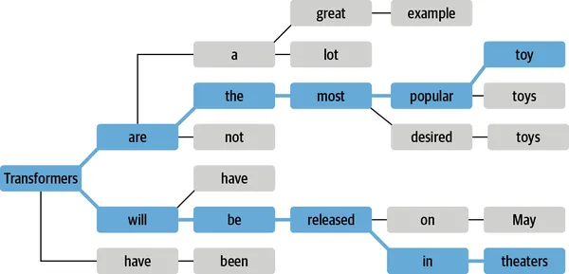
Decoding Example: Beam Search

Slide 30
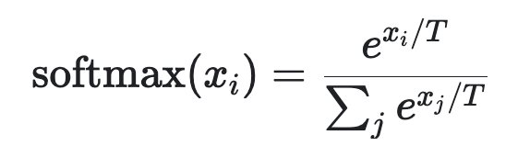
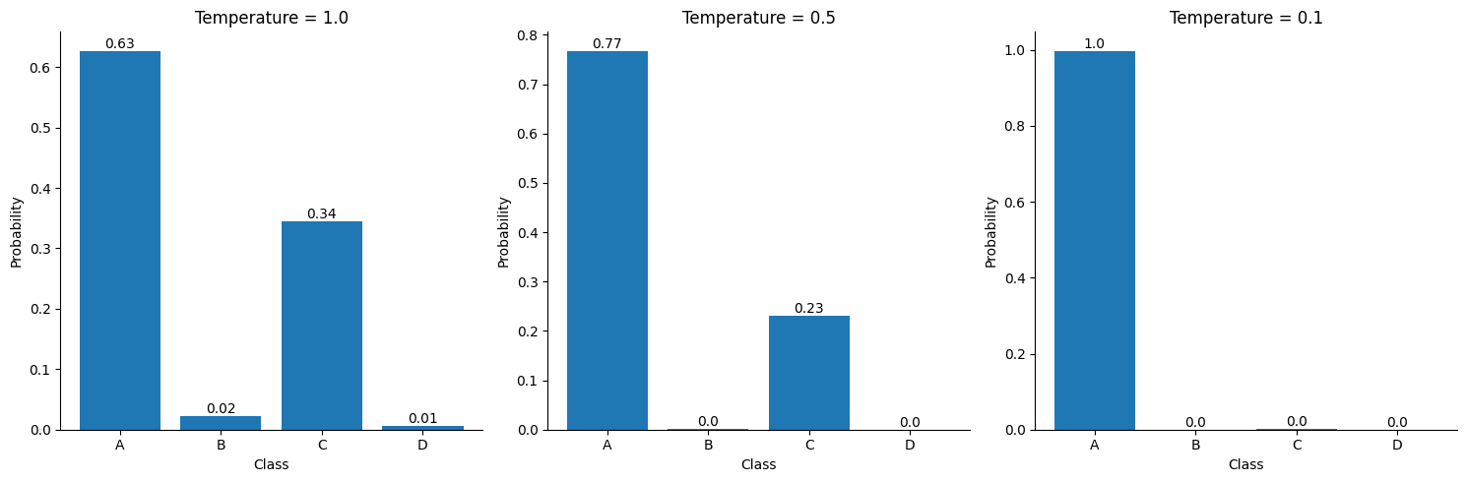
Decoding Example: Top-k
Suppose we have k=3 and four tokens: A, B, C, and D, with respective probabilities: P(A)=0.3 P(A)=30, P(B)=0.15, P(C)=0.05, and P(D)=0.1 . In top-k sampling, token D is disregarded, and the algorithm will output A 60% of the time, B 30% of the time, and C 10% of the time
The temperature T is a parameter that ranges from 0 to 1
👍 Low temperature means more determinism!
👍 Temperature is a knob you can control through most APIs
Decoding Strategies in Large Language Models

Slide 31
Demo: Exploring Logits (30 min)
Colab Notebook

Slide 32
Deep Dive into How Transformers Work: Version 1
The next few slides use graphics taken from Cohere’s blogpost “What Are Transformer Models and How Do They Work?”

Slide 33
The Transformer Architecture
https://txt.cohere.com/what-are-transformer-models/

Slide 34
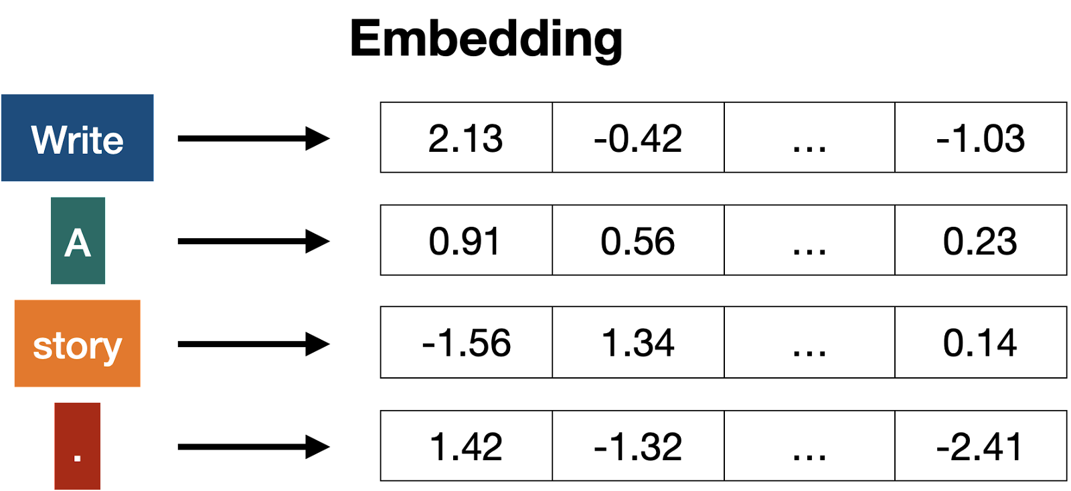
The “Embedding” Layer
https://txt.cohere.com/what-are-transformer-models/

Slide 35
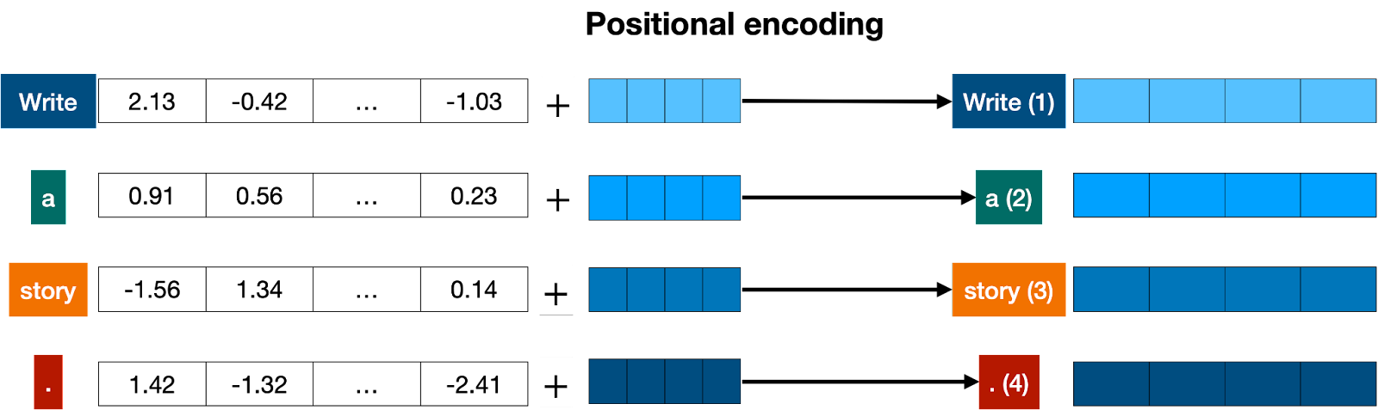
Positional Encoding
Positional encoding adds a positional vector to each word, in order to keep track of the positions of the words.
https://txt.cohere.com/what-are-transformer-models/

Slide 36
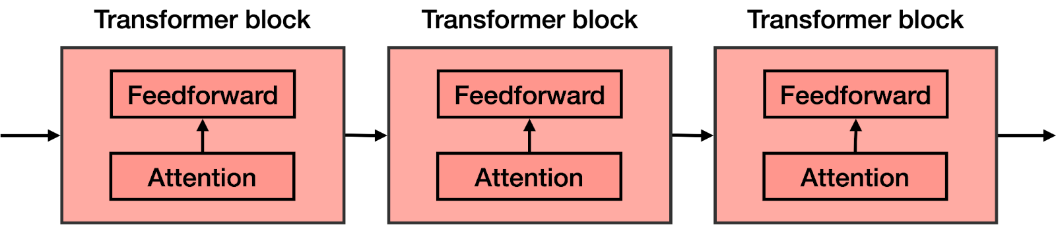
Transformer blocks & Attention
The attention mechanism in the transformer block is the key to the success of LLMs

Slide 37

What does the attention block do?
The attention mechanism is the key to the success of LLMs
https://txt.cohere.com/what-are-transformer-models/

Slide 38
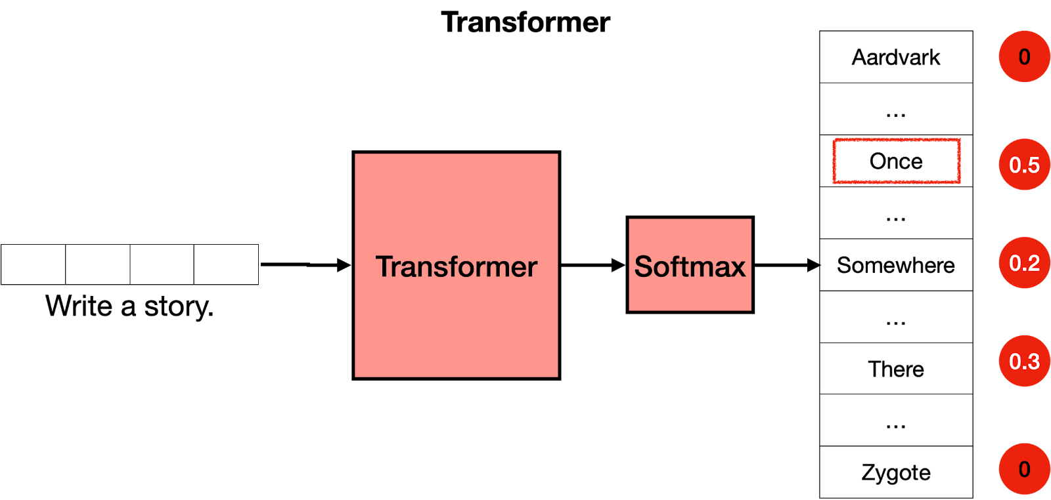
Softmax
The softmax layer turns the scores into probabilities, and these are used to pick the next word in the text.
https://txt.cohere.com/what-are-transformer-models/

Slide 39
Recap
https://txt.cohere.com/what-are-transformer-models/

Slide 40
Deep Dive into How Transformers Work: Version 2
The next few slides use graphics taken from Jay Alamar’s blogpost “The Illustrated Transformer”

Slide 41

Self Attention
https://jalammar.github.io/illustrated-transformer/

Slide 42
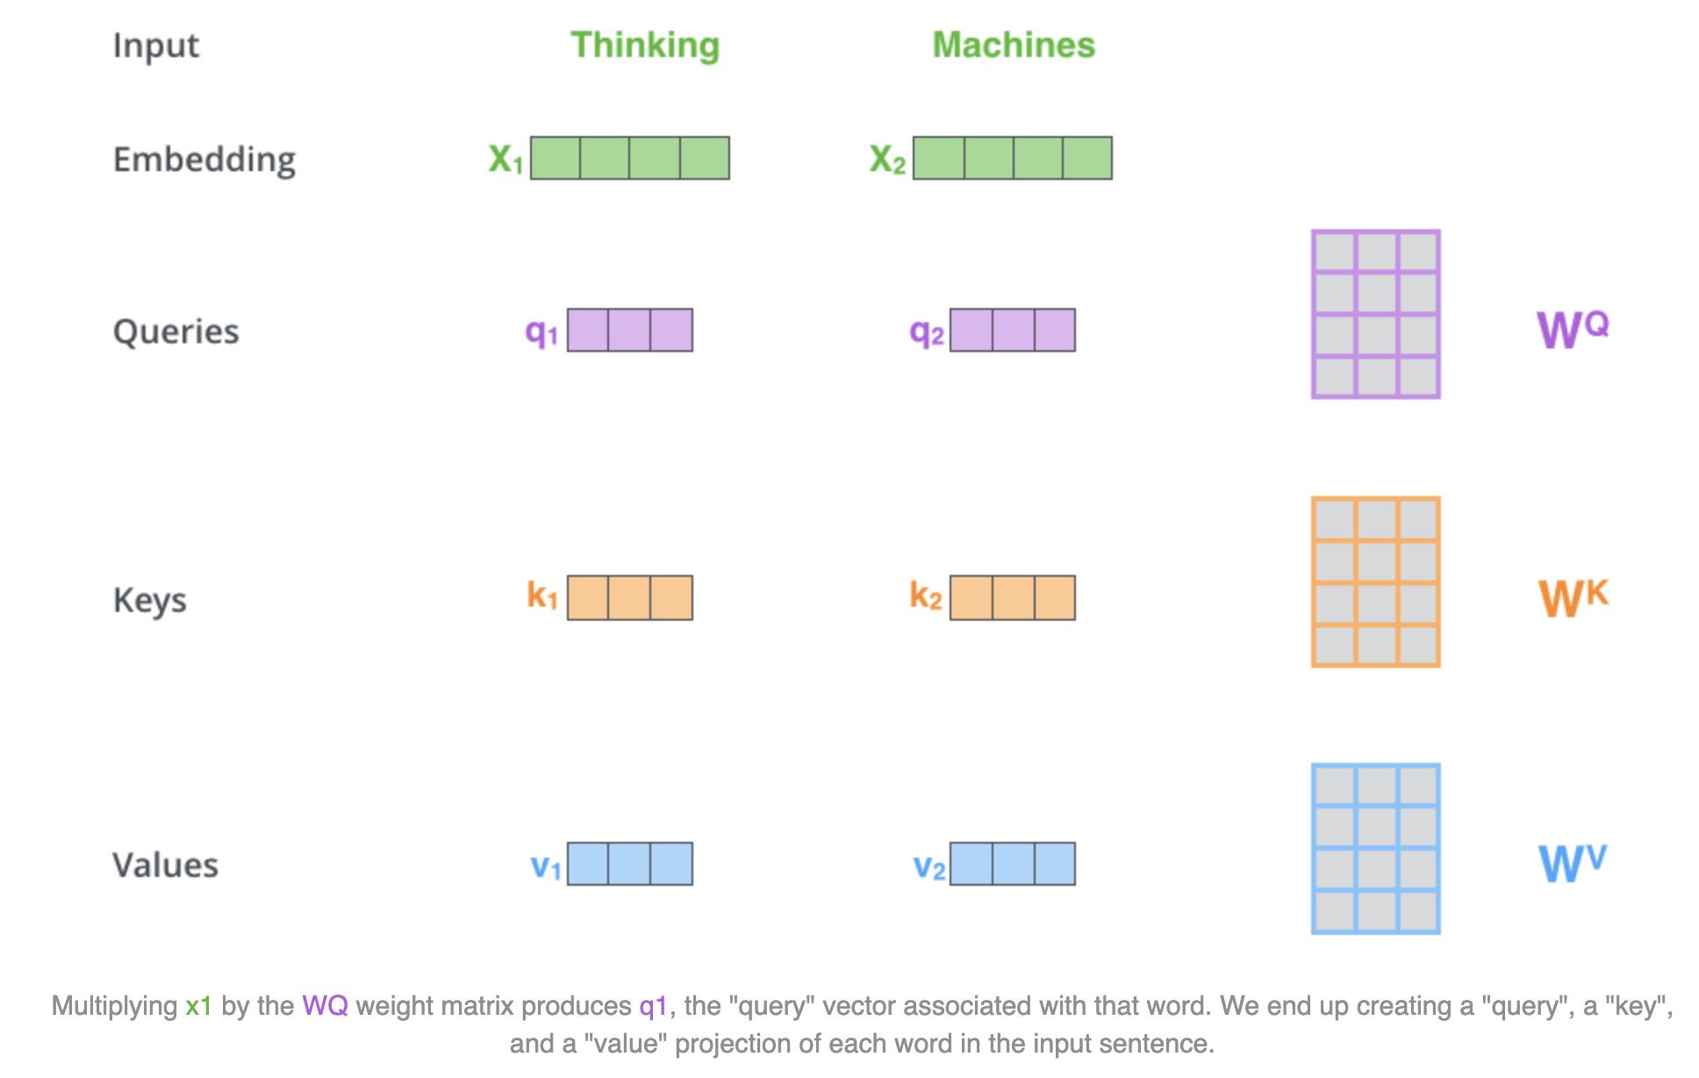
https://jalammar.github.io/illustrated-transformer/

Slide 43
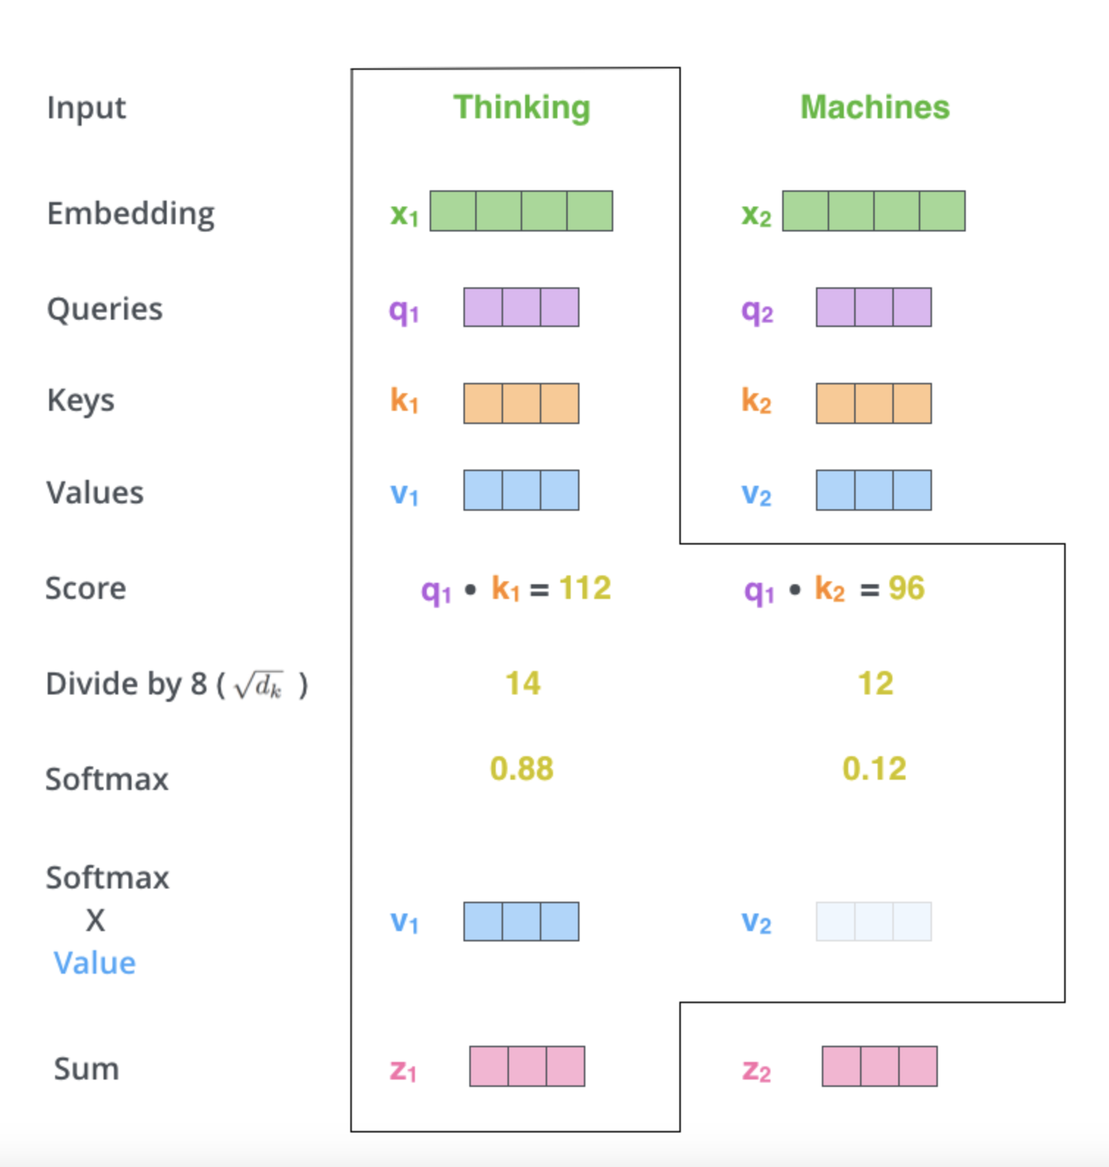
https://jalammar.github.io/illustrated-transformer/

Slide 44
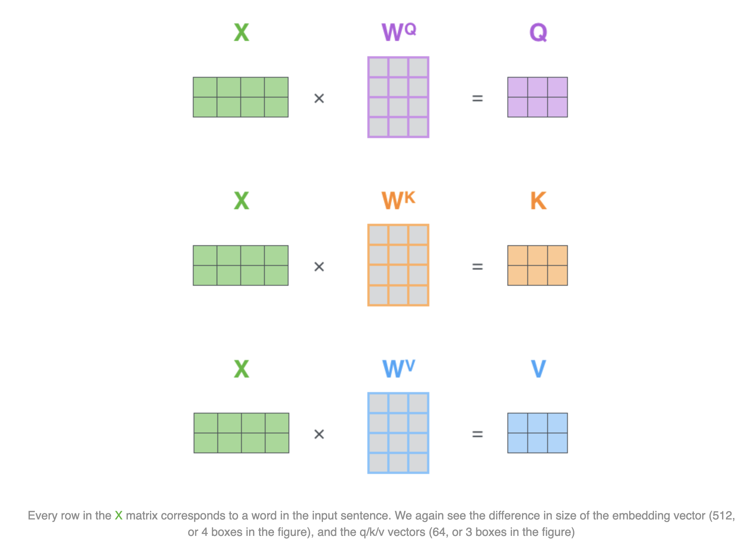
https://jalammar.github.io/illustrated-transformer/

Slide 45
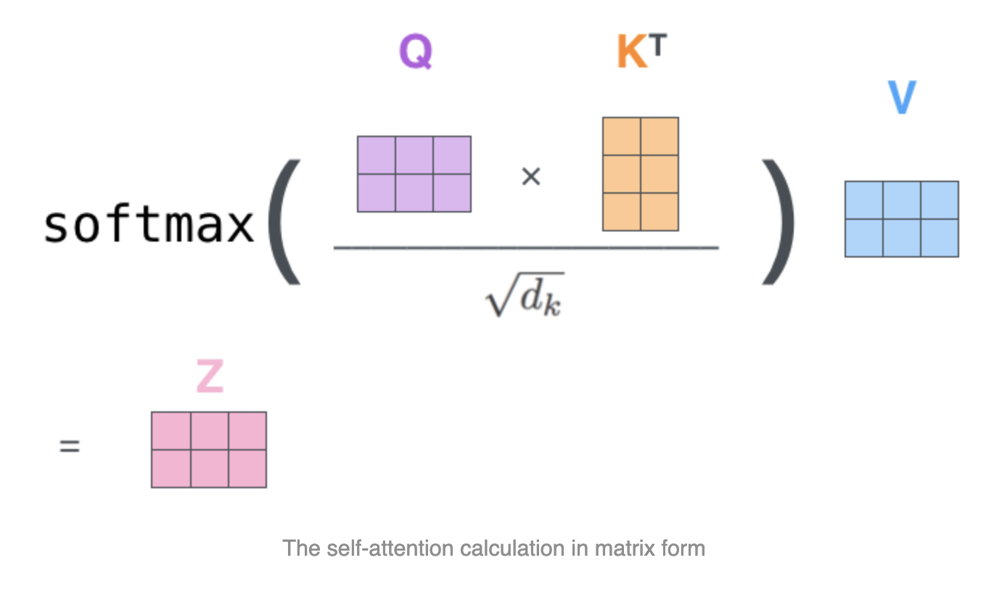
https://jalammar.github.io/illustrated-transformer/

Slide 46
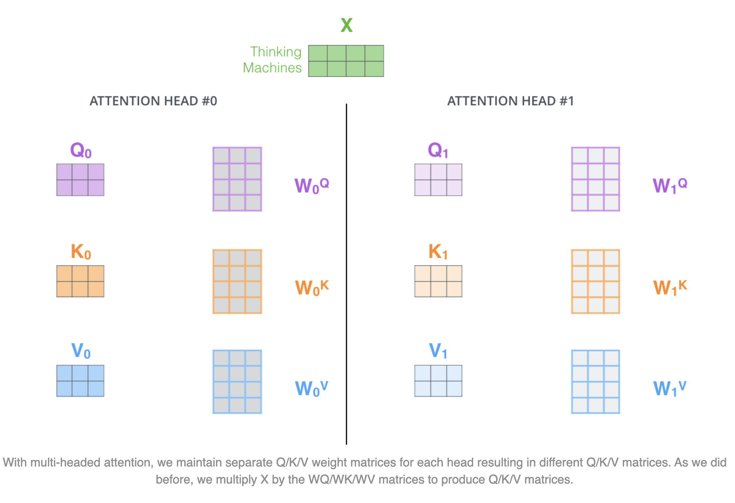
Multi Headed Self Attention
https://jalammar.github.io/illustrated-transformer/

Slide 47
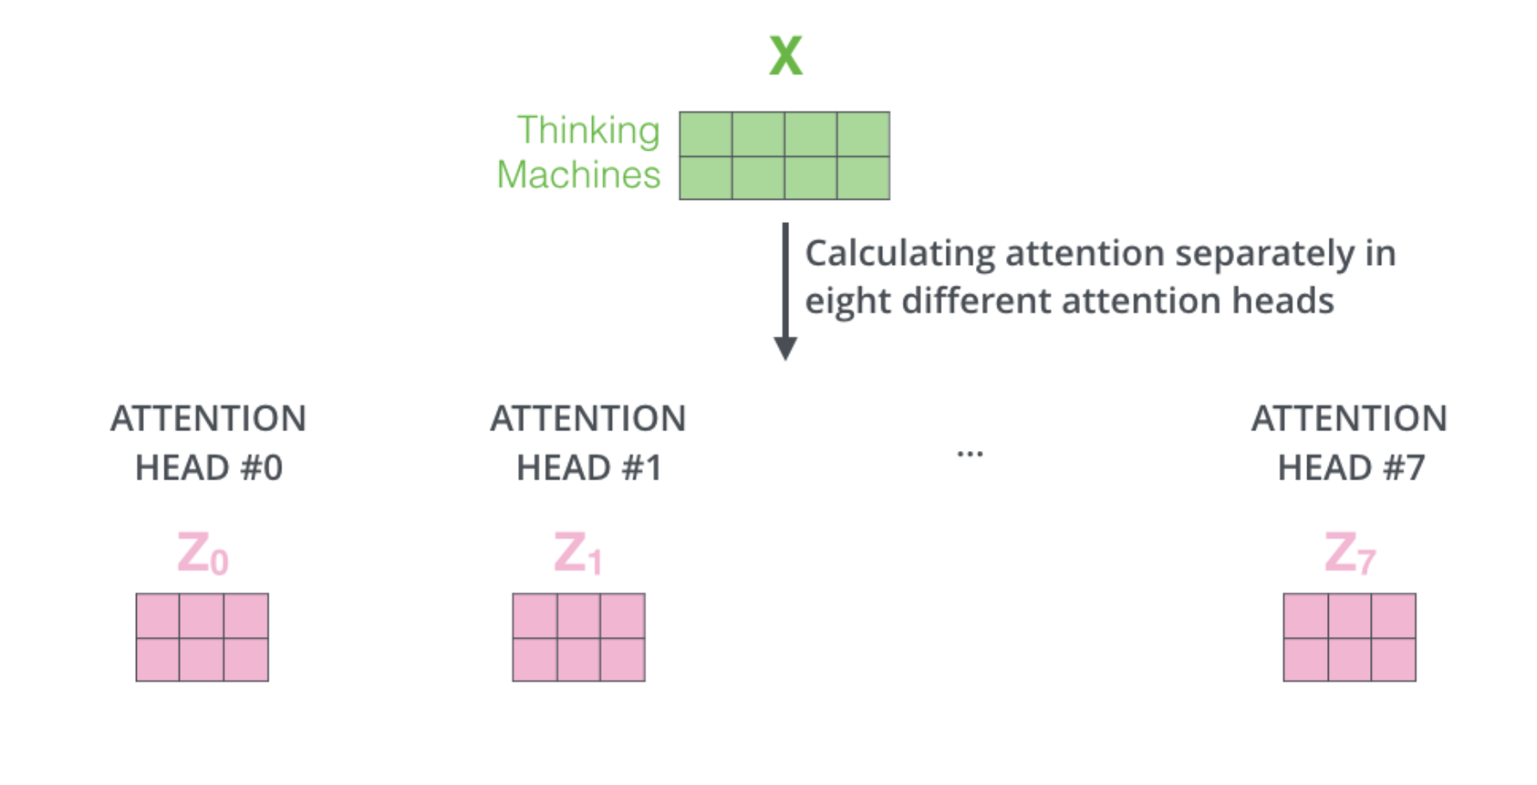
Multi Headed Self Attention
https://jalammar.github.io/illustrated-transformer/

Slide 48
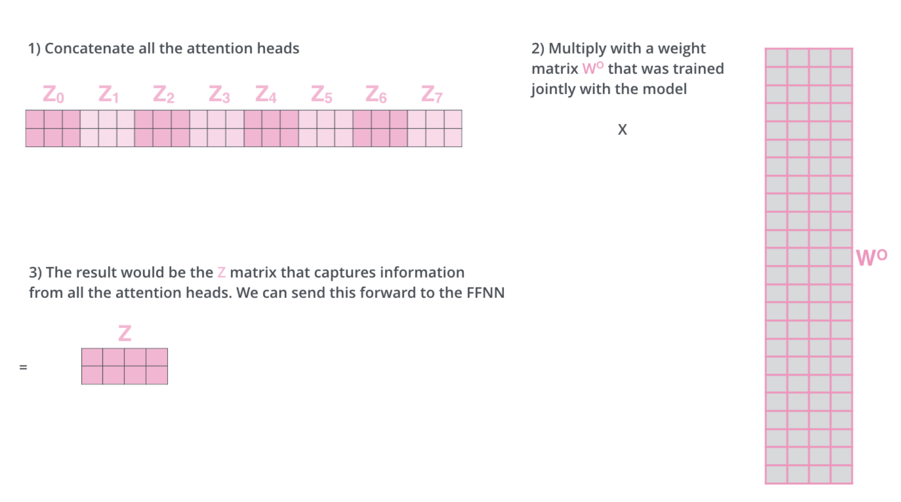
Multi Headed Self Attention
https://jalammar.github.io/illustrated-transformer/

Slide 49
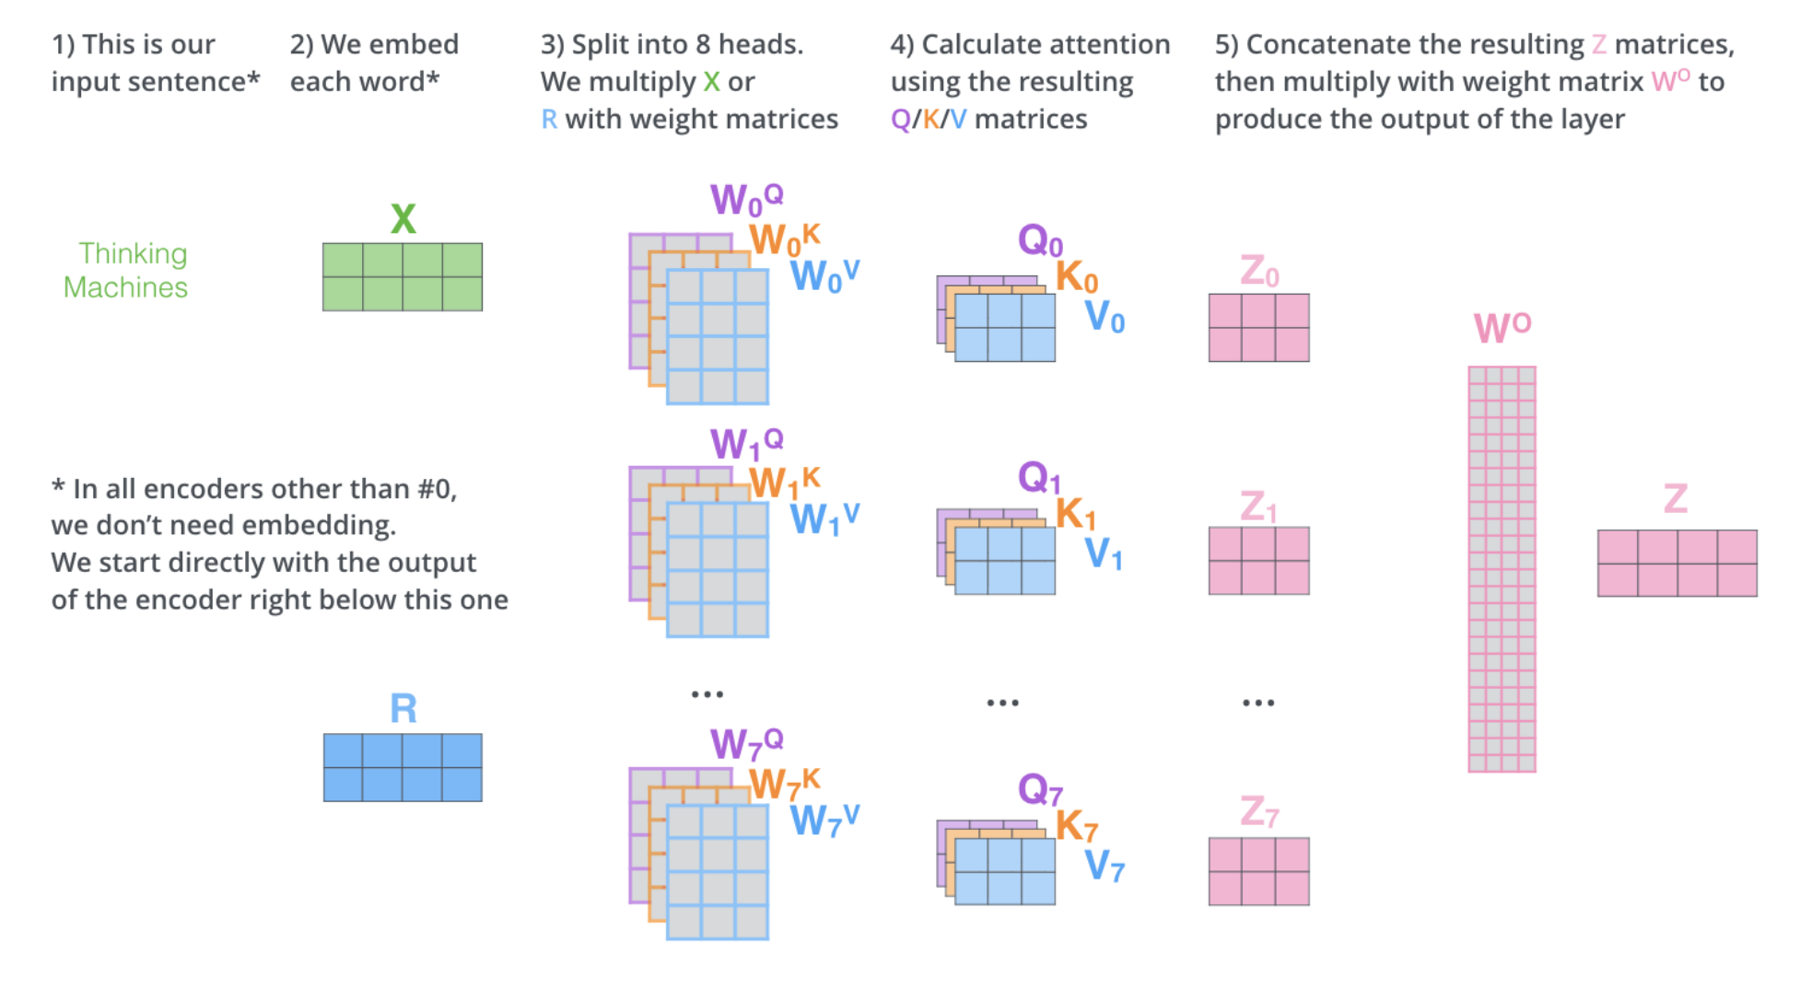
Multi Headed Self Attention
https://jalammar.github.io/illustrated-transformer/

Slide 50
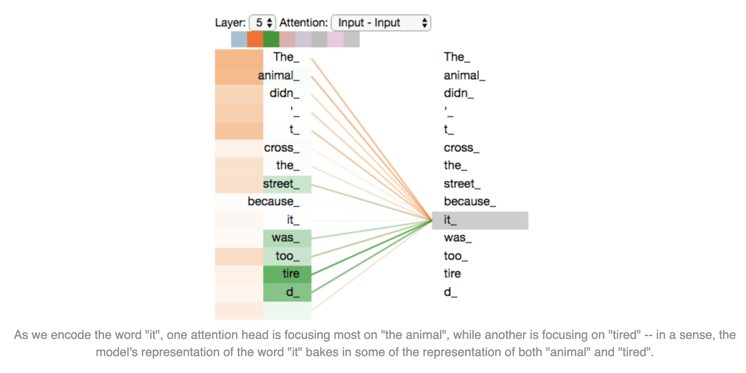
Multi Headed Self Attention
https://jalammar.github.io/illustrated-transformer/

Slide 51
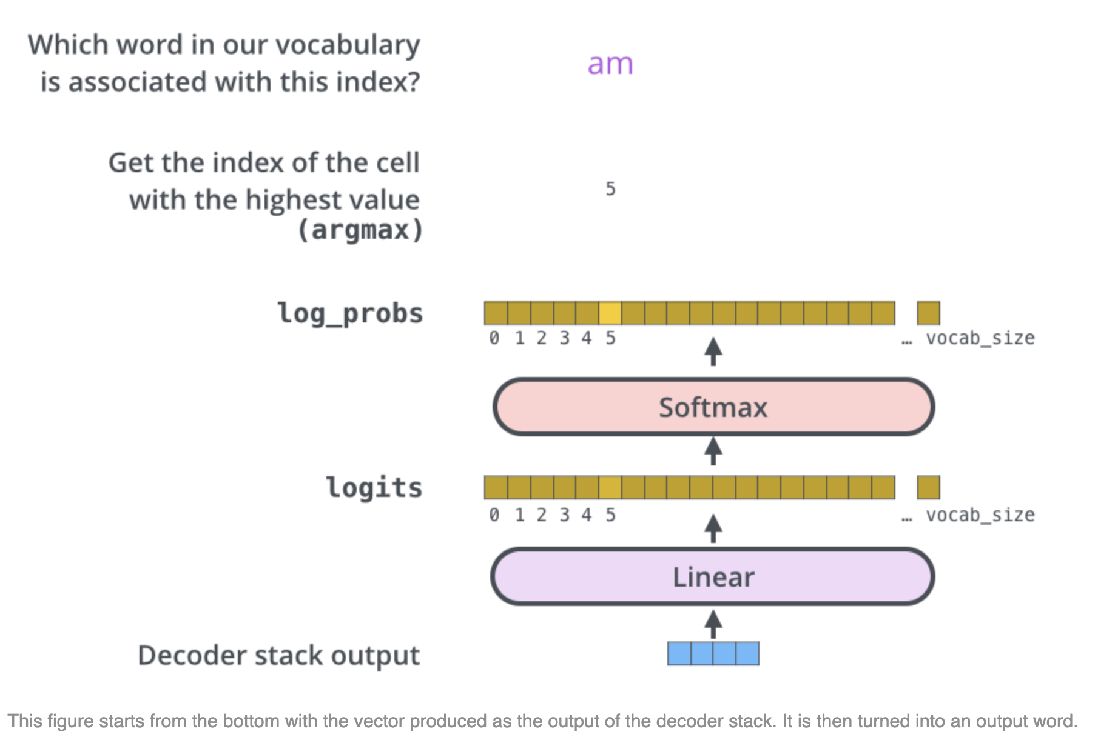
Bringing this back to logits…
https://jalammar.github.io/illustrated-transformer/

Slide 52
👍 Example LLM Details
Model | Status | Total # Parameters | # Transformer Layers | Pretraining Tokens | Vocab Size
GPT2-1.2B | Open Source | 1.2B | 12 | ~10B tokens | 50,257
GPT3-175B | Closed Source | 175B | NA | ~300B tokens | NA
Llama 7B | Open Source | 7B | 32 | ~2T tokens | 32,000
Llama 65B (aka Llama-70B) | Open Source | 65B | 80 | ~2T tokens | 32,000
DBRX | Open Source | 132B | 40 | 12T tokens | 100,352

Slide 53
Demo of Transformer (5 min) https://bbycroft.net/llm

Slide 54
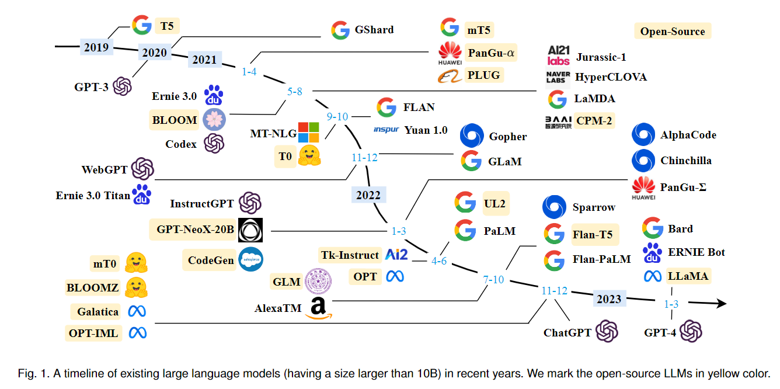
LLM History…
A Survey of Large Language Models

Slide 55
Why does it take more memory and time to train a LLM?
👉 FP16 = 2 Bytes of memory, FP32 = 4 Bytes of memory
INFERENCE/SERVING
Model parameters in FP16 → 2x the number of parameters. So a Llama-7B model uses at least 14 GB of memory to play with!
Why does it take more memory to train a LLM?
Model parameters
Model optimizer
Model gradient

Slide 56
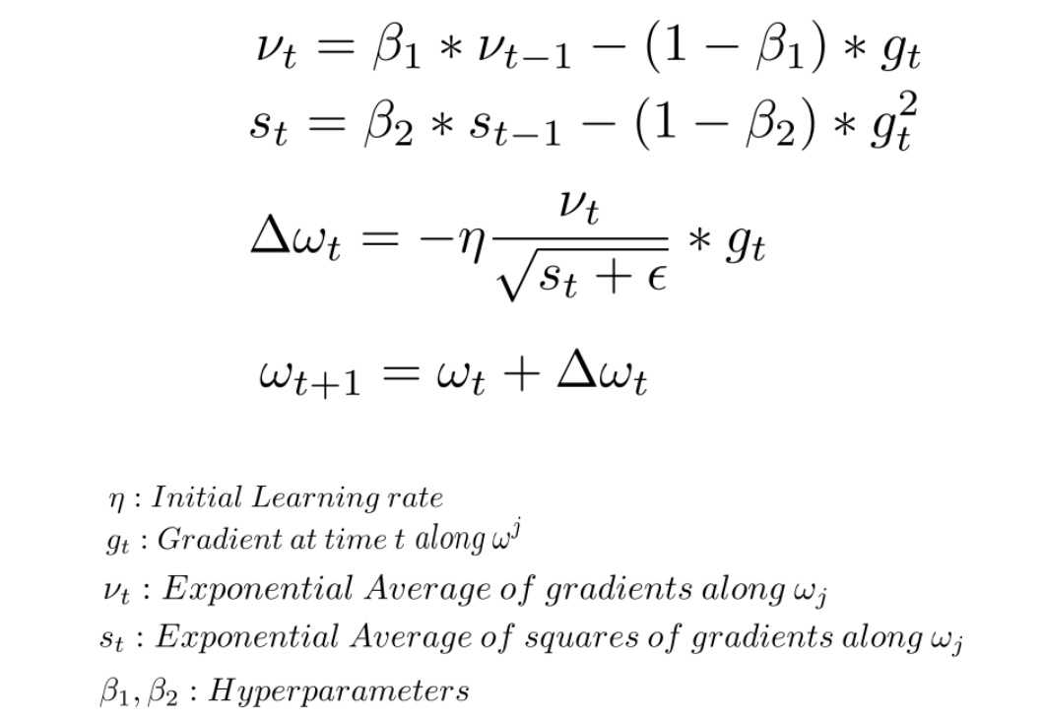
What is stored in GPU Memory?
TRAINING
Model parameters in FP16 → 2x the number of parameters
Model Gradients in FP16 → 2x the number of parameters
Optimizer State [Adam, all in FP32] → 12x the number of parameters
Model copy in FP32 → 4x the number of parameters
Momentum → 4x the number of parameters
Variance → 4x the number of parameters
See also https://d2l.ai/chapter_optimization/adam.html for code examples
momentum
variance
gradient g
weights w
https://discuss.pytorch.org/t/how-adam-optimizer-influence-the-learning-rate/168543 from the original Adam paper

Slide 57
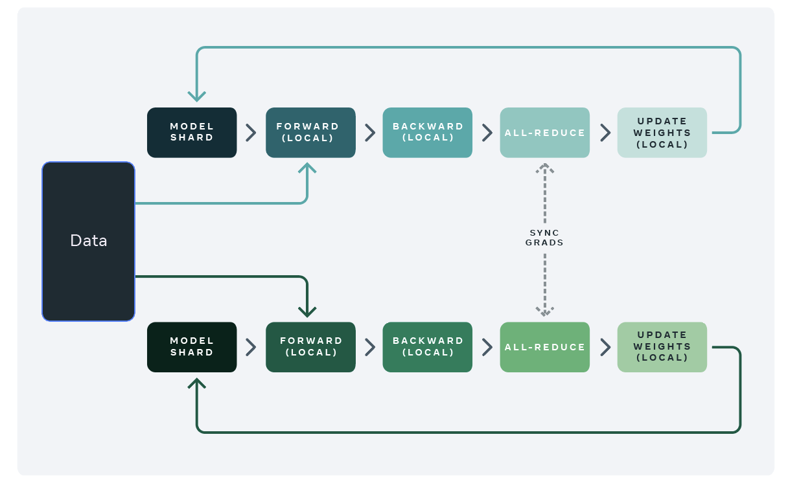
Distributed Data Parallelism (DDP)
This is the simplest way to train a model using many GPUs. Data is split among the GPUs for efficient training. Full model parameters are replicated on every GPU
GPU 1
The gradient has to be synced across all GPUs
GPU 2
https://engineering.fb.com/2021/07/15/open-source/fsdp/

Slide 58
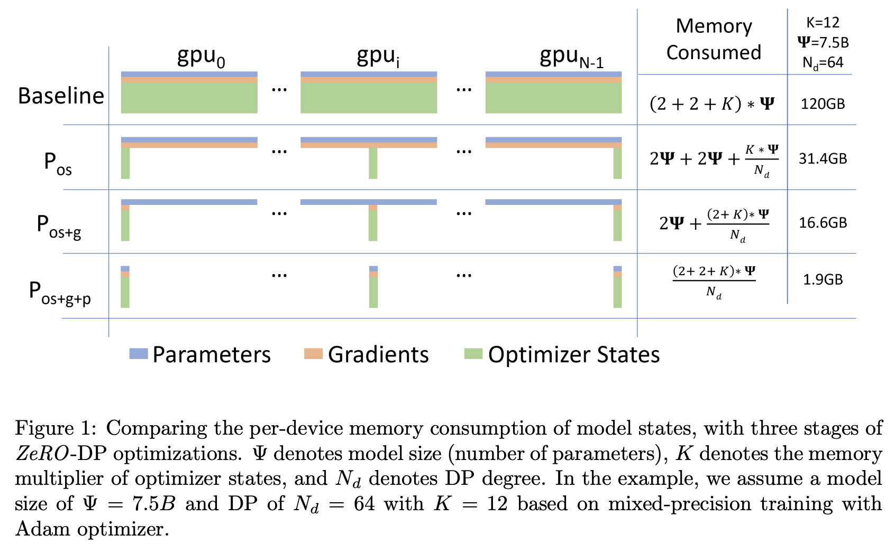
Example: Memory Consumption during LLM training
Model size 7.5B parameters
shard optimizer
shard optimizer + gradient
shard optimizer + gradient + parameters
ZeRO: Memory Optimizations Toward Training Trillion
Parameter Models
See also: How Fully Sharded Data Parallel (FSDP) works?

Slide 59
A Word About CPUs, GPUs and FLOPs
CPUs are general-purpose processors that can handle almost any type of calculation, less efficient at parallel processing.
GPUs, with their highly parallel architecture, are particularly well-suited for performing the massive number of floating-point calculations required for tasks like 3D rendering, machine learning, and scientific simulations.
When given a task, a GPU will divide it into thousands of smaller subtasks and process them concurrently, instead of serially.
FLOPS stands for "Floating-Point Operations Per Second" and is a measure of a computer's performance based on the number of floating-point arithmetic calculations its processor can perform within one second

Slide 60
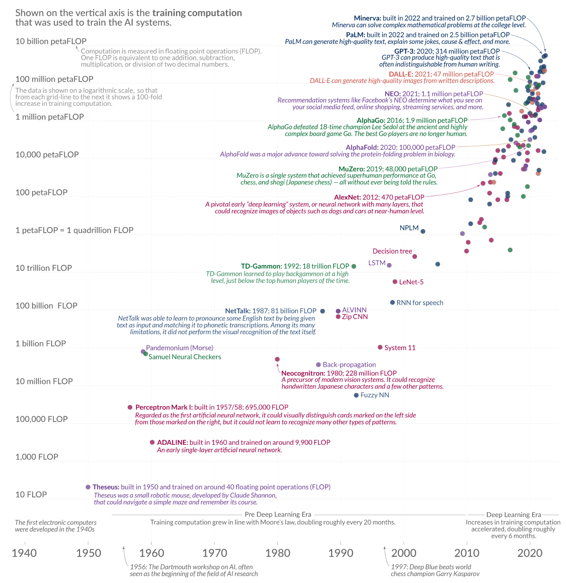
Why is “FLOPs” a useful metric for LLMs?
FLOPS = compute!
FLOPS is a function of both data amount and model size
In 2023, we are in the in the 100 billion petaFLOP range (1e26 FLOPs)
https://blog.heim.xyz/flop-for-quantity-flop-s-for-performance/

Slide 61
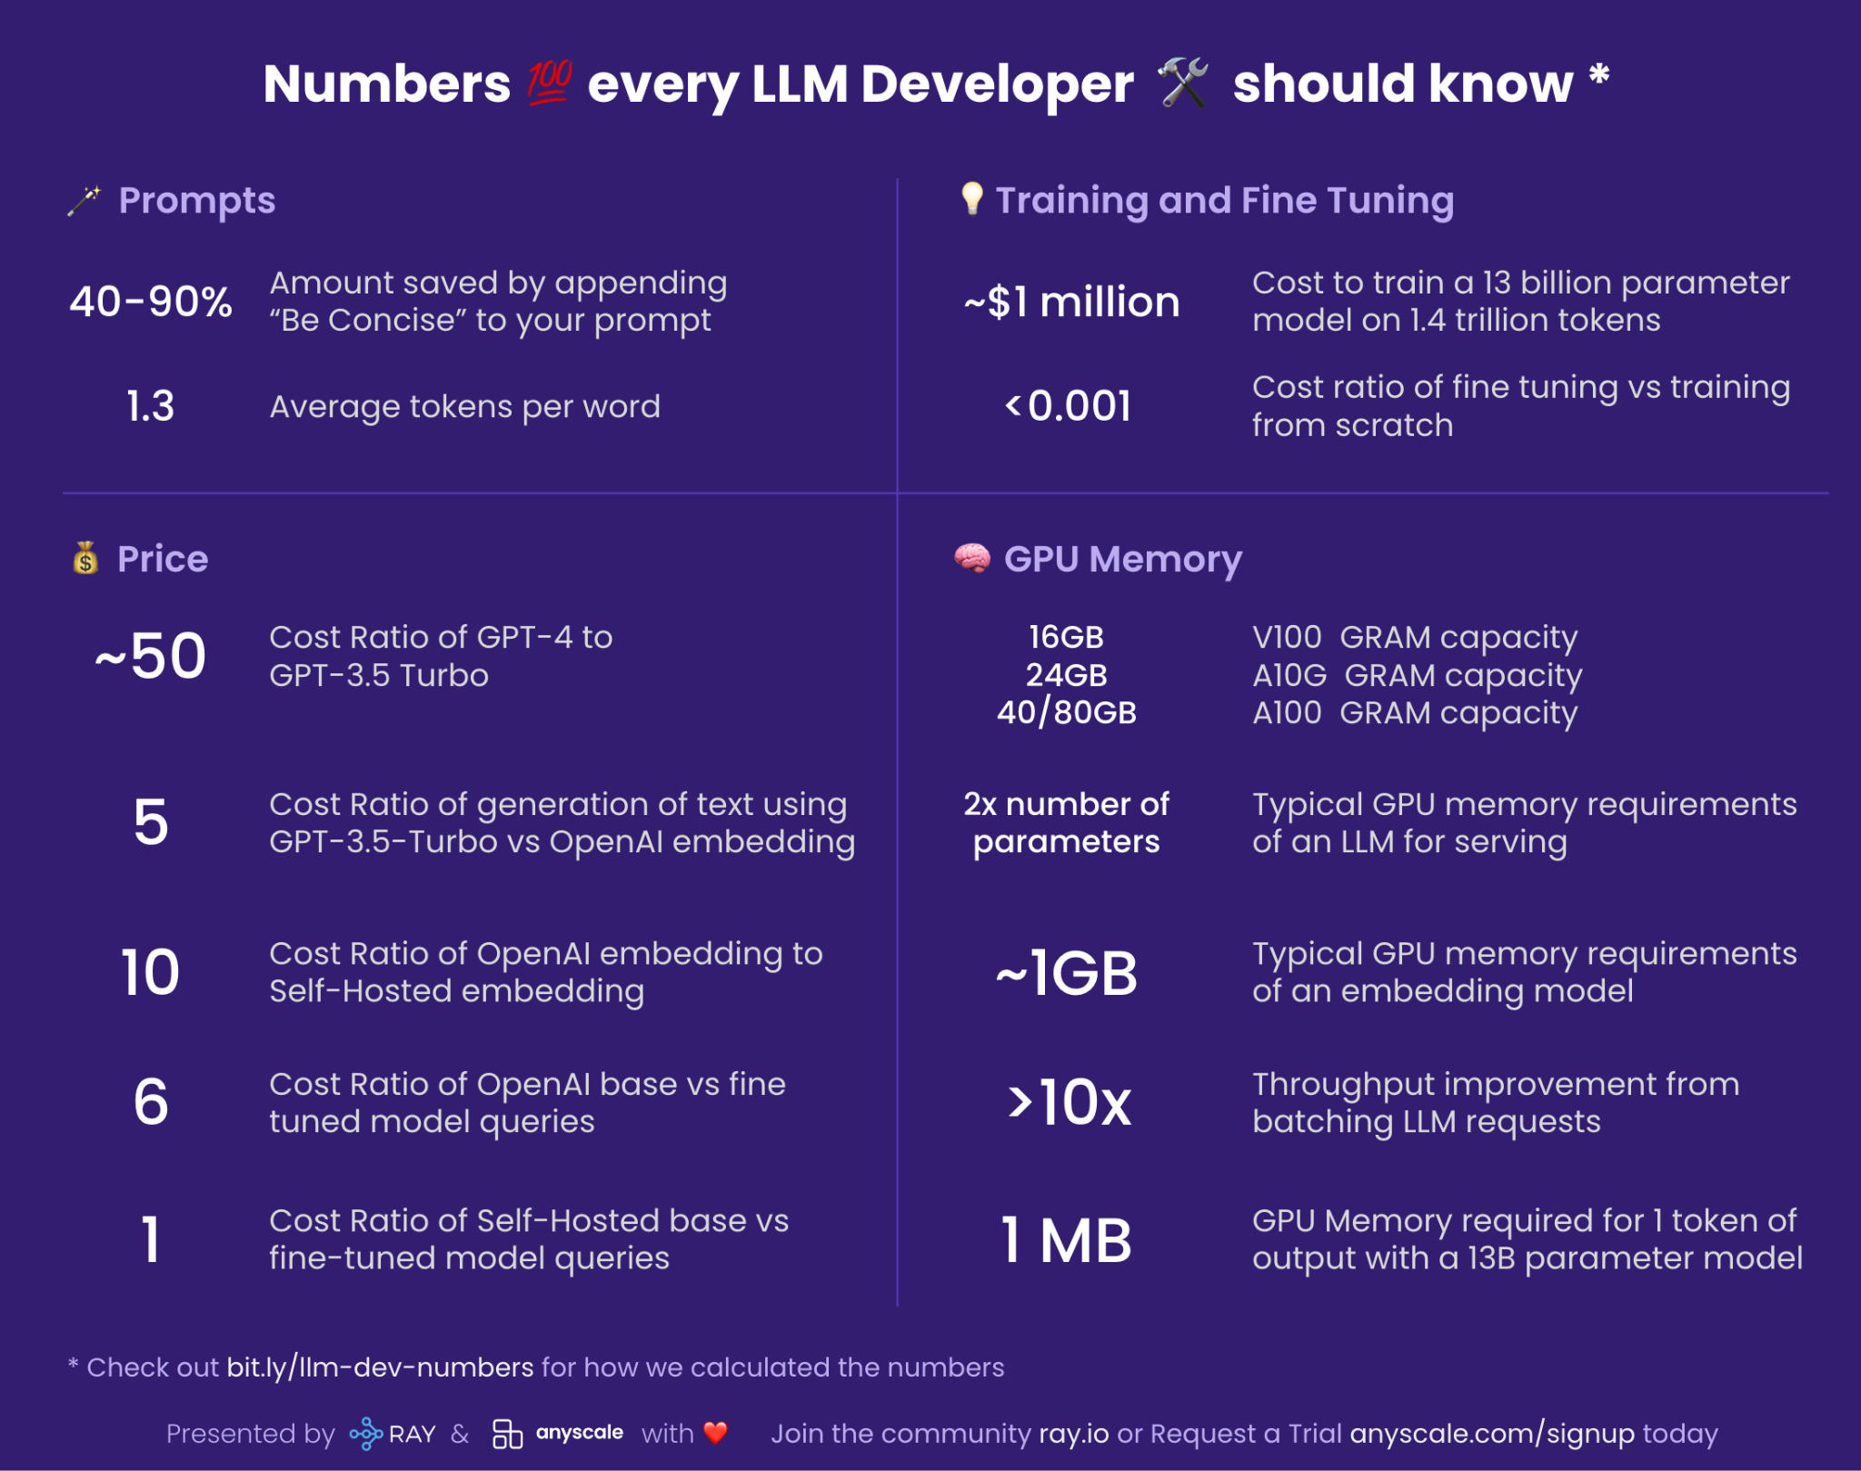
Serving
https://www.anyscale.com/blog/num-every-llm-developer-should-know

Slide 62
Part 3: Building with LLMs

Slide 63
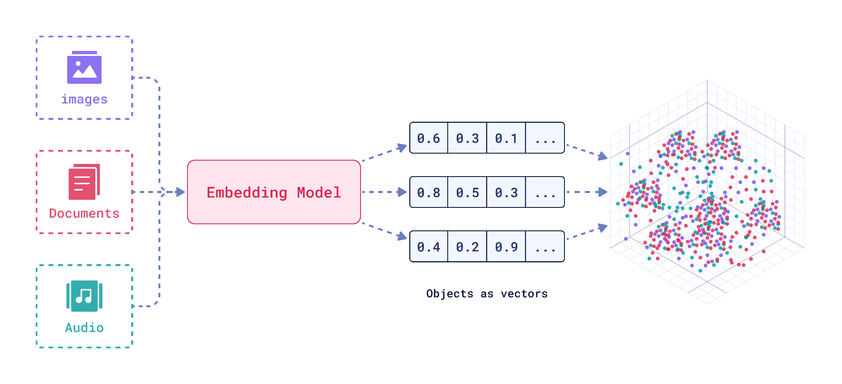
Vector Embeddings
https://qdrant.tech/articles/what-are-embeddings/

Slide 64


Vector Database
Vector databases store embeddings and allow you to search over embeddings
How do you efficiently store and search over billions of embeddings?
How do you handle updating the vectors in your vector database?
Example:
Search over Github issues
Search for images that look like you
Search for songs must similar to your music taste

Slide 65

Semantic Search

Slide 66

Retrieval Augmented Generation (RAG)

Slide 67

Langchain
https://python.langchain.com/docs/use_cases/tool_use/

Slide 68

Langchain
https://python.langchain.com/docs/use_cases/tool_use/

Slide 69
Miscellaneous Resources
Blog post: The Illustrated Transformer Jay Alammar, 2018
Blog post: The Bitter Lesson (Richard Sutton 2019)
Blog post: Alpaca: A Strong, Replicable Instruction-Following Model Taori, Gulrajani, Zhang et al. 2023
Blog post: Why we should train smaller LLMs on more tokens (Harm de Vries, July 2023)
Blog post: Google Gemini Eats The World – Gemini Smashes GPT-4 By 5X, The GPU-Poors Dylan Patel, Semi Analysis Newsletter
Blog post: Illustrating Reinforcement Learning from Human Feedback (RLHF)
Repo: https://minitorch.github.io/
Repo: RL4LMs
Youtube: Developing Llama 2 | Angela Fan (October 5, 2023)
RAG blogpost from LangChain and/or LlamaIndex TBD
Report of the 1st Workshop on Generative AI and Law Katherine Lee et al. 2023
Blogpost on prompt attacks: Extracting Training Data from ChatGPT (with accompanying paper by Nasr, Carlini et al. 2023) This blogpost that accompanies an academic paper highlights a recent approach for “jailbreaking” GPT4
Linden Li inference slides (How to serve LLMs)
How Fully Sharded Data Parallel (FSDP) works?
Mistral 7B’s secrets: a talk by Guillaume Lample

Slide 70
Miscellaneous Resources (cont.)
ML Collective Deep Learning: Classics and Trends https://mlcollective.org/dlct/. This is an open reading group that has weekly high quality talks. This is a great resource for up-to-date research, and has a strong community
ML Research Newsletter by Sebastian Ruder (Google Research) https://www.ruder.io/nlp-news/
HuggingFace NLP course: https://huggingface.co/learn/nlp-course/chapter1/1 This is a great resource for learning how to use HuggingFace’s libraries.
Cohere LLM course: https://docs.cohere.com/docs/llmu This is a gentle introduction to LLMs with Cohere’s API.
A hacker’s Guide to LLMs (Jeremy Howard) https://x.com/jeremyphoward/status/1707188542768865725?s=20
Visualization of the GPT/Transformer architecture https://bbycroft.net/llm
CS 189/289A Introduction to Machine Learning Spring 2023 (notes and youtube lectures)
Llama2: https://arxiv.org/pdf/2307.09288.pdf
Computational cost blog posts - Training: https://blog.eleuther.ai/transformer-math/ and Inference: https://kipp.ly/transformer-inference-arithmetic/
Model parallelism: https://huggingface.co/docs/transformers/v4.15.0/parallelism
Speculative decoding: https://arxiv.org/pdf/2211.17192.pdf
Roger Grosse’s course (with slides and readings) CSC2541 Winter 2022: Topics in Machine Learning: Neural Net Training Dynamics
Ana Marasović’s course (with slides and youtube links): CS 6966/5966, Fall 2023 Local Explanations for Deep Learning Models (University of Utah)
Modern language models refute Chomsky’s approach to language Steven T. Piantadosi This is a great article that explains how recent progress in LLMs completely upends classic (Chomskyan) linguistics
A Philosophical Introduction to Language Models Part I: Continuity With Classic Debates (Milliere and Buckner 2024)

Slide 71
Demo: Semantic Search (30 min) 🛠️
Colab Notebook

